Slide 1
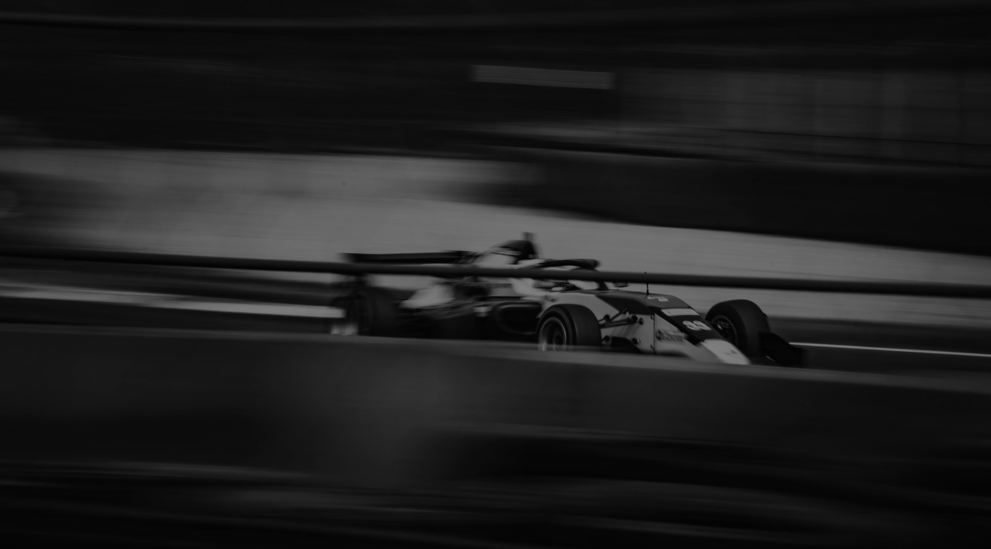
Five9 x SPORTFIVE RECOMMENDATION: THE BEST FIT FOR Five9
EXEMPLARY
Rights package
TGR HAAS F1 TEAM
PARTNERSHIP
Brand & IP Rights
Official Partner designation
Associated IP and promotional rights
Car & Team Branding
Car branding, potentially 2 positions
Driver, mechanic and team principal apparel
Selected team assets
Activation
Driver and team appearances, in-market and virtual
Replica/show car usage
Simulator usage
Digital & Social
Digital and social media support
Co-branded content
Partner presence on the team website
Hospitality
Paddock access
Paddock Club tickets
Hospitality and paddock branding
Business Value
B2B introductions across the team’s partner network
Merchandise allocation
Licensing opportunities
39

Slide 2
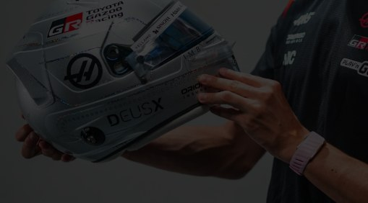
Five9 x SPORTFIVE RECOMMENDATION: THE BEST FIT FOR Five9
EXEMPLARY
Rights package
OLLIE BEARMAN
ATHLETE PARTNERSHIP
Brand & IP Rights
Official ambassador designation
Territory: global
IP Usage
Digital and social media
OOH and TVC
POS and retail marketing
Helmet Branding
Five9 branding on Ollie’s helmet
At all 24 Formula 1 races
Content & Social
Production time with Ollie
Social media usage
Experiences
Meet & greets
Signed merchandise
Formula 1 Paddock Club hospitality
Investment
Fee: $2–2.5M p.a.
39

Slide 3

Five9 x SPORTFIVE RECOMMENDATION: THE BEST FIT FOR Five9
EXEMPLARY
Rights package
TENNIS
AMBASSADOR
Brand & IP Rights
Official Ambassador designation
Territory: global
IP Usage
Digital and social media
OOH and TVC
POS and retail marketing
Experiences
Meet & greets
Signed merchandise
Content & Social
Production time
Social media posts
Hospitality
Hospitality tailored to Five9’s needs
Investment
Djokovic: $2M
Zverev: $1.5M
Jódar: $1M
Shelton: $1.5M
39

